Slide 1
Family Preparedness for Immigrant Families

Slide 2
INTRODUCTION:
LEGAL SERVICES NYC & OUR CLIENTS

Slide 3

The largest civil legal services organization in the U.S.
Legal Services NYC’s (LSNYC) mission is to fight poverty and seek racial, social, and economic justice for low-income New Yorkers.
We help New Yorkers obtain the basic necessities of life, including housing, economic security, family and immigration stability, education, health care, and challenge the systemic injustices that trap people in poverty.

Slide 4

LEGAL SERVICES NYC
5 Boroughs
700+ Dedicated Staff
110,000+ New Yorkers Helped Annually

Slide 5
PROGRAM AREAS
Consumer Rights.
Tenant/Housing Rights.
Employment.
Foreclosure Protection.
Family Law.
Veterans Justice.
Access to Benefits.
Disabilit.
Education.
Immigration.
Anti-Discrimination Work.
Disaster Relief.
Tax.
Veterans Justice
Access to Benefits
Disability
Education
Immigration
Anti-Discrimination Work
Disaster Relief
LGBTQ/HIV
Consumer Rights
Housing
Employment
Family Law

Slide 6
OUR CLIENTS
Low-income New Yorkers, usually at or below 200% of poverty.
Federal poverty line = approximately $15,960 for an individual.
2 million New Yorkers live at or below 100% of the poverty line.
4.6 million New Yorkers live at or below 200% of the poverty line.
6

Slide 7
Our pro bono work by the numbers
150+ clinics annually
4,100+ pro bono cases handled annually by firms/corporations
100 firms and corporations
4,750+ volunteers
$80M value of donated time

Slide 8
Clinic Agenda
Importance of Family Preparedness and Goals for the Clinic
Family Preparedness Documents Overview
Tips for Working with our Clients and Using Interpreters

Slide 9
PART I
Introduction: Importance of Family Preparedness and Goals for the Clinic

Slide 10
Importance of Emergency Preparedness Planning
Over half of children in New York City have at least one immigrant parent, with many living in “mixed-status” families.
With rising immigration enforcement, parents are worried about who will care for their children if they are detained or deported, even if they have a lawful basis for staying in the US.

Slide 11
Importance of Emergency Preparedness Planning
Planning helps give client control over what happens to their children.
Planning can minimize the chances of children being place in foster care.
Planning helps ensure proposed caretakers know in advance what their responsibilities are.

Slide 12
Importance of Emergency Preparedness Planning
Decisions concerning children's care, supervision and other needs:
Physical Custody
  Avoid unnecessary ACS involvement
  Avoid abusive parent involvement
• Medical needs
• Educational Needs
• Financial Needs
• Traveling Decisions
• Where the child(ren) will reside
• Other major decisions

Slide 13
Goals for safety plan
Empower parents
  Parents can prepare and retain as much control as possible over what happens to their children
  Parents can better understand their options for short term and long term planning (e.g., consultation with a family law lawyer)
Avoid gaps in care
Facilitate family conversations
Plans should be realistic!

Slide 14
PART II
Document Overview

Slide 15
Overview of Documents
DOCUMENT A – Creating a Safety Plan
DOCUMENT B – Emergency Contact Information
DOCUMENT C – Information About You
DOCUMENT D – Information About Your Child(ren)
DOCUMENT E – U.S. Passport Application
DOCUMENT F – Consent to Travel
DOCUMENT G – Blue Card Update
DOCUMENT H – Designation of Person in Parental Relationship
DOCUMENT I – Standby Guardianship
DOCUMENT J – Power of Attorney

Slide 16
DOCUMENT A – Creating a Safety Plan
This document provides an overview of all the things to consider when planning for potential separation from children, including:
  Meet with family members and caregivers to discuss plan in case of immigration enforcement.
  Consider saving money for bond/bail and for other costs and loss of income.
  Carry telephone numbers of attorney and family members to call if needed.
  Make a list of things that the children should do if parents do not come home.

Slide 17
Document A – Creating a Safety Plan
Review Document A: Creating a Safety Plan
  This will give the client an overview of the things they should do to prepare for the possibility of detention or deportation
  Remind the client the purpose of safety planning, i.e., to give people control about what will happen in the future even if some things are outside their control

Slide 18
DOCUMENT A – Creating a Safety Plan
Remind clients to keep a file of important documents (including immigration papers) in a safe place, AND keep a copy of documents with a friend or family member that they trust:
  These family preparedness documents
  Court orders (custody, visitation, divorce judgment, orders of protection, child support)
  Marriage license
  National identification cards
  Passports, driver's license or other identification cards, like social security card or ITIN number
  Registries of birth (for U.S. born children registered in your home country)
Offer to make copies for the client

Slide 19
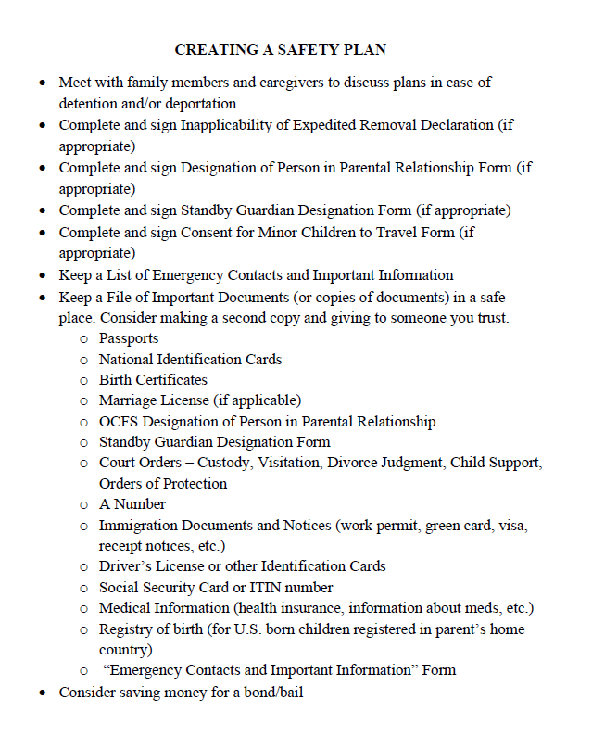

Slide 20
DOCUMENT B – Emergency Contact Information
A list of people who can help the clients' child(ren) in their absence.
Share with trusted family members/friends.
Save in a place that is accessible to other relevant family members/friends.

Slide 21
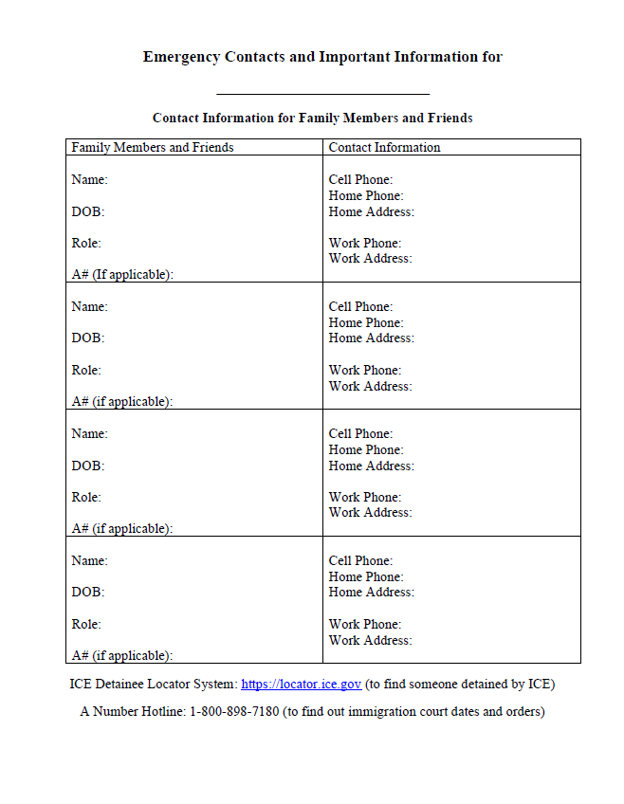

Slide 22
DOCUMENT C – INFORMATION ABOUT CLIENT
Keep track of information about the client like their employer, attorney, medications, medical providers, assets, etc.
Keep in a safe place and share with those who would be responsible for the client's family in the event of an emergency.

Slide 23
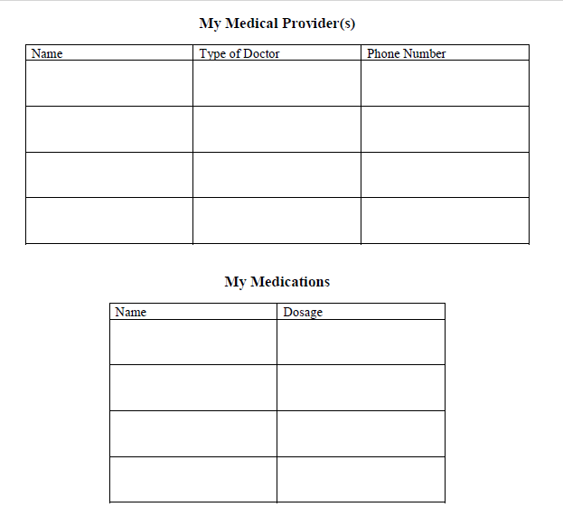
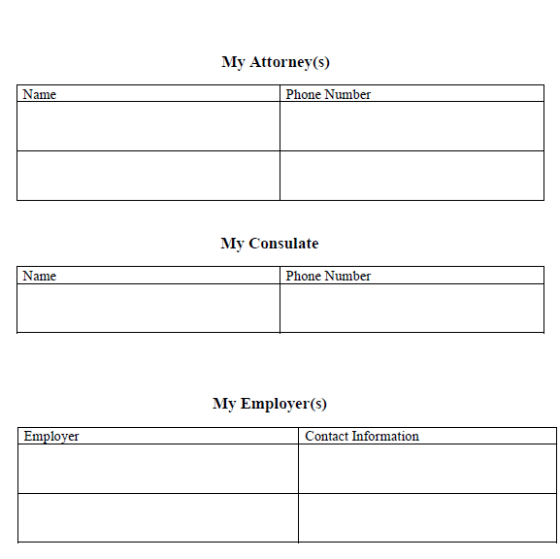
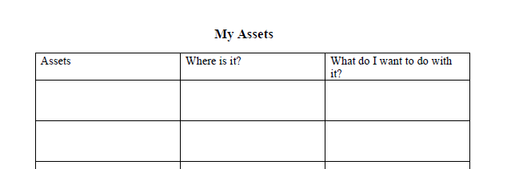
DOCUMENT C – INFORMATION ABOUT ADULT
Review and help fill out Document C: information about the adult
Includes attorney, consulate, employer, medical providers and medications, and assets

Slide 24
DOCUMENT D – INFORMATION ABOUT OUR CHILD(REN)
Create a document that contains all of the important information a caretaker would need about the child(ren).
Create one of these sheets for each child.
This should include information about their school, teachers, and doctors, and their routines, interests, and other miscellaneous information. Feel free to create additional columns to provide additional information.
Share with the person who will be responsible for the child(ren):
  This could be the other parent, the person client designates to be a standby, or the person client designates to travel with the child(ren).

Slide 25
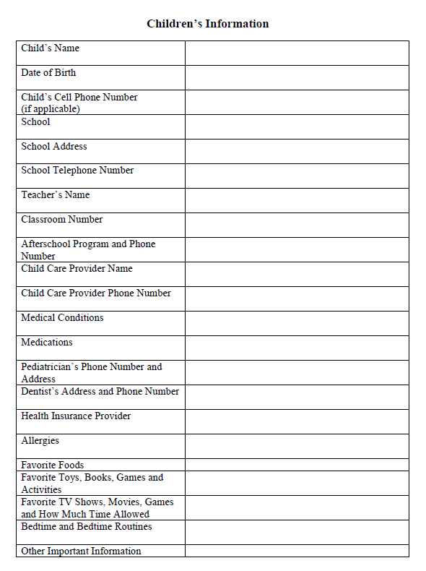

Slide 26
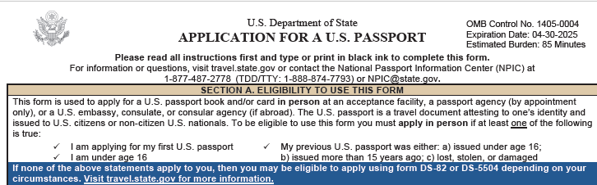
DOCUMENT E – U.S. Passport Application
Parent should complete if the child is a U.S. citizen.

Slide 27
DOCUMENT E – U.S. Passport Application
Client's child(ren) will need a passport to travel outside of the United States.
If the child(ren) is not a U.S. citizen, work on obtaining a passport from the child(ren)’s home country so they can travel if needed. Check with the consulate or embassy for the client's home country.
This will be much easier to do now and will be much more difficult in the event the client is detained or deported.

Slide 28
DOCUMENT F – Consent to Travel
If client intends for the child(ren) to return to their home country in the event of deportation, they will need to complete a Consent for Minor Child to Travel.
Travel permission is needed if they would like someone to accompany their minor child on a trip abroad
  Each parent should sign one, or client must explain why the other parent’s permission cannot be obtained or is not necessary.
  Other parent MUST also consent to the travel, unless the other parent is deceased (need a copy of the death certificate) or client has a court order allowing the child(ren) to travel outside the U.S. (attach copy of court order).
If the client would like to authorize their minor child to travel abroad alone, check their airline’s policy for travel by unaccompanied minors.
Notes:
consent for minor children to travel.pdf

Slide 29
DOCUMENT F – Consent to Travel
It must be signed in front of a notary public. The child should travel with their original birth certificate and passport, as well as with copies of the documents listed on the Travel Permission form.
Give the completed notarized form to the designated person the child(ren) would travel with in case of emergency.
Verify requirements of country child would travel to (e.g., visa).
Reminder: child will need a passport to travel internationally.
Notes:
consent for minor children to travel.pdf

Slide 30
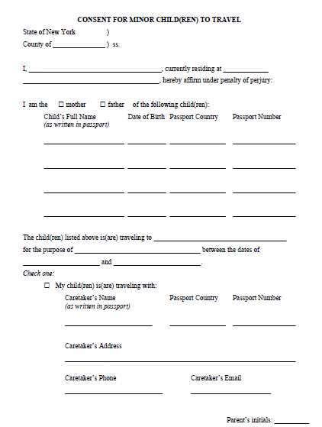
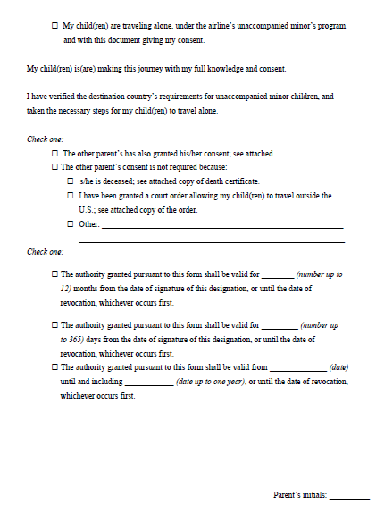
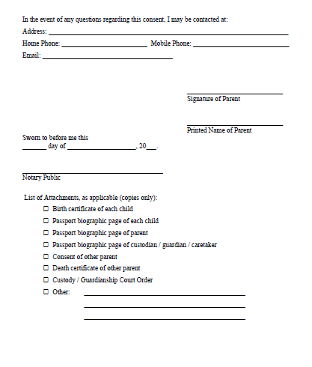

Slide 31
DOCUMENT G – Blue Card Update
New York City Public Schols Blue Card should be completed by anyone who has school-age children.
Need to have a backup person because if no one picks up the child, schools are mandatory reporters and are required to notify the Administration for Children Services ("ACS").
  Client can list up to four people to contact in case child has emergency or is sick at school.
Update now with the school with a letter (see sample), in person with the school, or online at https://www.schools.nyc.gov/docs/default-source/default-document-library/emergency-contact-card.pdf
Call the school to confirm the information was updated.

Slide 32
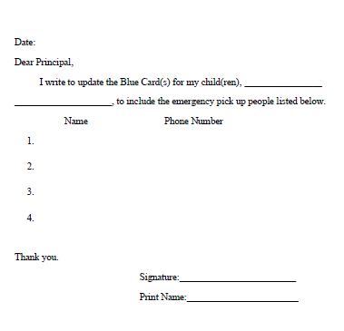

Slide 33
DOCUMENT H – Designation of Person in Parental Relationship
Who should use this form?
  Immigrant parents who want to plan immediately for their children without going to court
What rights does this form give?
  Does not affect parental rights and can be revoked at any time.
  Empowers the designee to make educational & medical decisions for the child.
    E.g., review school records, enroll in school, excuse absences from school, consent to participate in school program, consent to medical/dental care, enroll in health plans, etc.
    One limit to medical decision is designee cannot consent for surgery and other "major medical treatment".
  Children do not have to change schools regardless where designee lives.

Slide 34
DOCUMENT H – Parental Relationship
How long does it last?
  Up to 12 months, and can be renewed indefinitely.
  Can use triggering event for it to become effective.
  If signed, effective for 30 days. If signed and notarized, can be more than 30 days and up to 12 months. Parents can sign and notarize from abroad.
  Can be revoked at any time, orally, or in writing.
Who needs to sign?
  One parent can sign, unless there is a court order that requires both parents to consent to educational and medical decisions (e.g., joint custody)
More informal caregiver agreements could be sufficient, but this form is supported by explicit statutory authority, so helpful for certain situations (e.g., where children have special educational or medical needs).

Slide 35
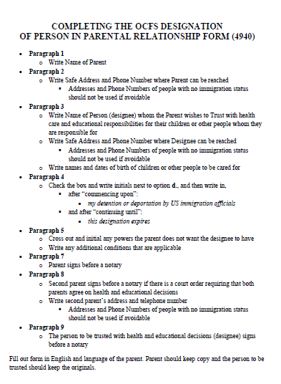
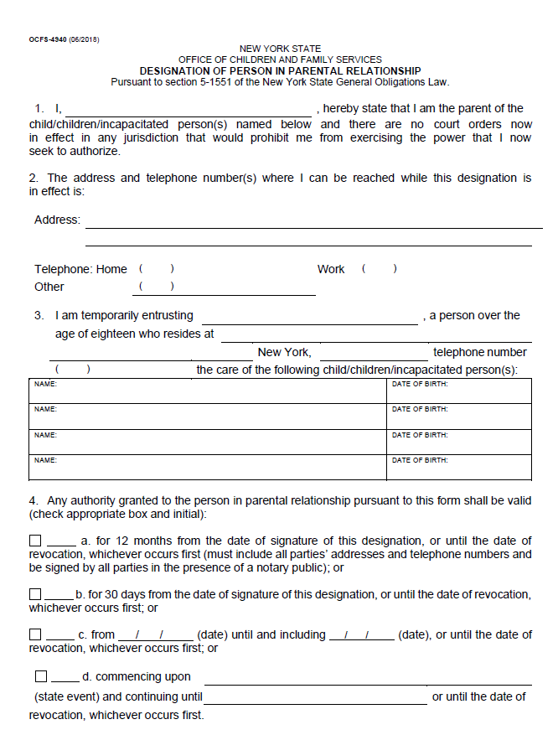

Slide 36
DOCUMENT H – Parental Relationship
Next steps:
Provide the original to the designated person and keep a copy for the client's records.
If triggering event was specified, have designated person attach proof of event, e.g., detention or deportation.
  Proof of detention at www.ice.gov/locator
  Immigration Court removal order
  Proof of deportation can be sworn statement from parent

Slide 37
DOCUMENT I – Standby Guardianship
Client may want to create a guardianship to ensure that the child is able to receive immediate care from someone that the client trusts and designates.
  This guardianship gives temporary authority for someone else to care of your child(ren).
  If the client intends for the child to remain in the U.S. in the event they are deported, they should consider designating a standby guardianship.
The person designated as the standby guardian (18+) would need to file in court within 60 days of the event that caused the separation.

Slide 38
DOCUMENT I – Standby Guardianship
The designation must be:
  Signed by the parent;
  Completed in the presence of two witnesses over 18; and
  Signed by the standby guardian.
Standby guardian cannot be one of the witnesses
Each parent must complete a separate document

Slide 39
DOCUMENT I – Standby Guardianship
The designation should include a statement that the parent believes the standby guardian would serve the best interests of the child.
The parent may also designate an alternate guardian in the event the primary guardian is unable or unwilling to serve.
The parent must also state why the other biological parent is not an appropriate guardian (i.e., deceased, abusive, resides out of the country).
The potential guardian needs to sign in front of a notary but can do this at a later time.

Slide 40
DOCUMENT I – Standby Guardianship
Considerations when choosing a guardian
  Financial and emotional stability.
  No history of crime or history of allegations of child abuse or neglect.
  Immigration Status – U.S. citizen or lawful permanent resident recommended.
    More stable and not likely to be subject to own arrest, detention or removal;
    If proposed guardian lacks status, advisable to speak with counsel before going to court.
  For older children (over 14), consider their wishes.
  Willingness of proposed guardian.

Slide 41
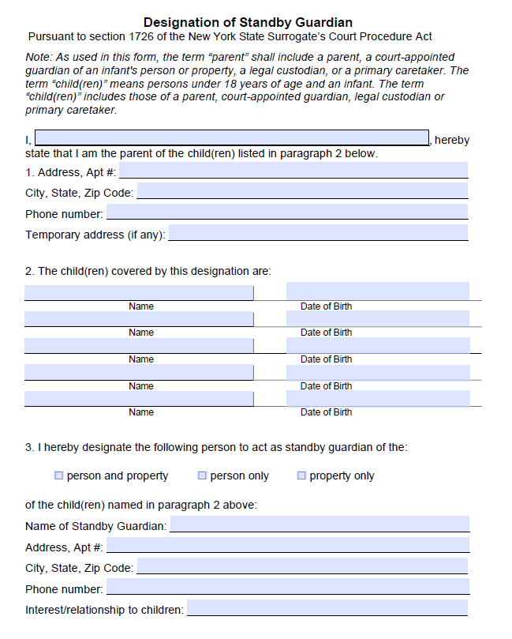
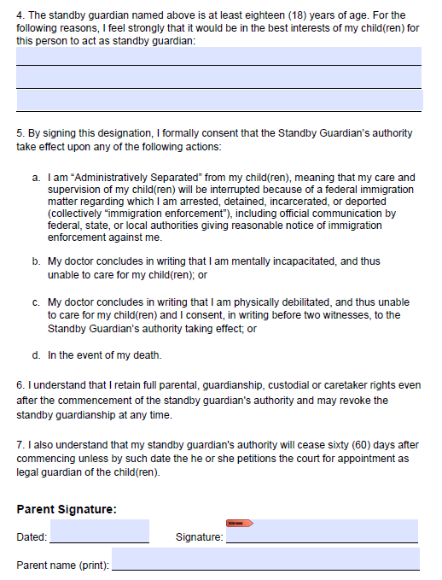
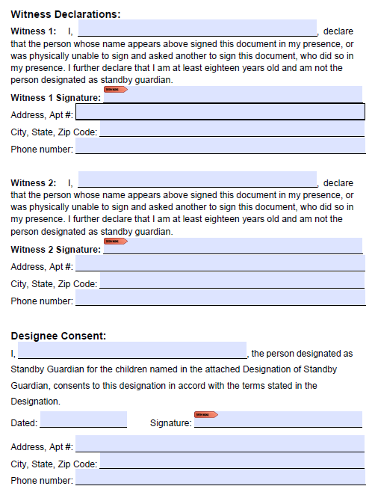

Slide 42
Risks of Court Involvement
Although having an order of guardianship or custody can be helpful in terms of establishing someone’s rights regarding the child, there are many risks with going into court for custody, guardianship, or standby guardianship:
Other parent must generally be notified of court proceedings.
Other parent can call ICE to come to court: especially dangerous if one parent already has final removal (deportation) order.
Other parent may reappear after absence and file own petition, and parents will have greater “standing” than others.
Consider speaking with a family law attorney about these considerations!

Slide 43
DESIGNATION VS. STANDBY GUARDIANSHIP
Designation does not involve the court
  The parent retains full parental rights
  The parent can revoke and/or re-designate at any time
  Effective immediately – i.e., parent may fear picking up child at school due to ICE presence in the neighborhood
Standby guardianship is future-facing
  Authority does not begin until a triggering event (detention or illness)
  Before that, potential guardian has no clear authority with schools or medical providers
Designation can work immediately
  Authorizes a chosen adult to make education and health decisions now
  Schools and providers recognize this form and will act on it without a court order

Slide 44
 | Designation of parental relations | Standby guardianship | Guardianship
Goal | To designate a trusted person to make decisions regarding child's healthcare and educational needs. | To appoint a person or persons to take care of children and their property in parent’s stead. | A court process, where a family court appoints a guardian for a minor (under the age of 21).
Parental rights | Parents do not lose their parental rights. | Parents do not lose their parental rights. | Parents do not lose their parental rights per se. Parents will be given notice about proceedings unless they abandoned a child.
Honored by which agencies? | Schools, medical facilities, some NYS and possibly federal government agencies | Schools, medical facilities, some NYS and possibly federal government agencies | Schools, medical facilities, most NYS and federal government agencies
When comes into effect | Can designate it to commence upon the parent’s detention or deportation | After the “administrative separation” caused by immigration detention or deportation | When NYS family court appoints a guardian
Duration in effect | Can be set but cannot exceed 12 months. Can be set for 30 days, 12 months, or a specific period/until revocation | 60 days after the administrative separation | It may be in effect until the children are 18 or 21.
Process of execution | Needs to be signed and notarized by: Custodial parent(s) Non-custodial parent who has legal custody Designee | Needs to be signed in front of two witnesses, who are not the standby guardian | The person seeking guardianship appointment or the children must petition the NYS family court. The court must determine that it is in the children’s best interest for such appointment.

Slide 45
DOCUMENT J – Power of Attorney
This form is used to give power to someone else to the client's manage money or property during the client's lifetime.
  It does not directly concern care or custody of children, but is limited to property matters such as bank account, apartment lease, insurance matters, health care billing, and public benefits such as Medicaid or social security.
Standby guardianship provides for someone to care for the child, while PoA provides the financial and administrative continuity to support that care.

Slide 46
DOCUMENT J – Power of Attorney
Must be notarized, but the person you designate as the agent can sign and get notarized later.
Must be able to trust the agent with handling money and property.
Copies of a completed PoA are legally valid.
Note: there may be other options to help clients handle their belongings in their absence and they might not need to execute a power of attorney in certain circumstances.

Slide 47
DOCUMENT J – Power of Attorney
Housing and basic needs
  A PoA allows the agent to use the parents' funds to pay rent, utilities, groceries, phone, etc. so the child can remain stably housed.
Public benefits and agencies
  Most benefits (SNAP, Medicaid, SSI/SSA, HRA) are in the parents' name as payee.
  Agencies often require the parent to sign, recertify, or resolve issues.
  PoA allows agent to keep benefits active without parent present.
Avoid delay and court
  Without PoA the caregiver may not have access to the parents' finances and may need to rely solely on their own to care for the child.

Slide 48
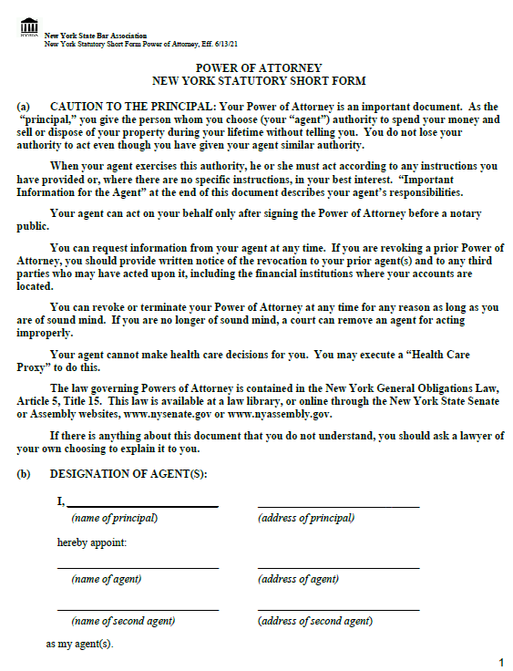

Slide 49
PART III
Tips for Working with LSNYC Clients

Slide 50
Remote Representation Tips
Always ask client if they are in a safe space where they can talk privately;
Discuss whether the client has access to reliable phone service or WiFi;
Be flexible – phone calls could drop; you or the client might have to pause or end the conversation for different reasons;
Establish the best method of communication early on and be mindful of client’s circumstances and offer alternatives.
Notes:
Brief the interpreter
Identify yourself.
Provide specific instructions of what needs to be accomplished.
2. Speak directly to the parent(s)
• Communicate directly with the parent as if the interpreter is not present.
• The interpreter will relay the information and then communicate the parent’s response directly
back to you.
3. Speak naturally, not loudly
• Speak at a normal pace and volume.
• Speak in one or two sentences at a time. Try to avoid breaking up a thought. The interpreter
is trying to understand the meaning of what you are saying, so express the entire thought at
once if possible.
• Pause after expressing a thought to ensure that the interpreter has enough time to deliver
your message.
• If something is unclear, or if you have a long statement, the interpreter will ask you to repeat
all or part of what you said, or to clarify your meaning.
4. Ask if the parent understands
• Do not assume that an LEP parent understands you. In some cultures, a person may say
“yes” as you explain something, not meaning that they understand you, but rather that they
want you to keep talking because they are trying to follow the conversation.
• Keep in mind that a lack of English does not indicate a lack of education.
5. Do not ask the interpreter for their opinion
• The interpreter’s job is to convey the meaning of the source language and not allow personal
opinion to color the interpretation.
• Do not hold the interpreter responsible for what the parent does/does not say.
6. Everything you say will be interpreted
• Avoid private conversations. Whatever the interpreter hears will be interpreted.
• If you feel that the interpreter has not interpreted everything, confirm s/he has done so.
• Avoid interrupting the interpreter while s/he is interpreting.
7. Avoid jargon or technical terms
• Do not use slang, idioms, acronyms, or DOE specific terms that parents may not understand.
• Clarify unique vocabulary and provide examples to explain a term as needed.
1
8. Length of interpretation
• When you are working with an interpreter, the conversation can often take twice as long as it
would take in English only.
• Many concepts that you express will have no equivalent in other languages, therefore the
interpreter may have to describe or paraphrase many of the terms that you use.
• Interpreters will often use more words to interpret what the original speaker says simply
because of the grammar and syntax of the target language.
9. Reading scripts
• People often speak faster when reading a script. When you are reading a script, prepared
text, or disclosure, slow down to give the interpreter a chance to keep up with you.
• Provide the interpreter with a copy of your script.
10. Culture
• Professional interpreters are familiar with the culture and customs of the LEP parent. During
the conversation, the interpreter may identify and clarify a cultural issue of which they may
think you are not aware.
• If the interpreter feels that a particular question is culturally inappropriate, s/he might ask you
to rephrase the question to help you obtain the information in a more appropriate way.

Slide 51
Setting Expectations
Introduce yourself and describe your role
  Your role is to help the client fill out essential forms to help the family prepare for the possibility of detention or deportation.
  Clients may not be prepared to finalize every document on the day of the clinic, and it's OK to schedule other meetings with them.
  Be sure they understand next steps (e.g., coming into your office or locating local notaries).
Set expectations
    Explain that you are helping them with the preparation of the forms and you are not an immigration or family law attorney, but LSNYC can help connect them with someone:
      e.g., family lawyer to discuss long term guardianship
      e.g., immigration lawyer to discuss immigration relief options
Notes:
Brief the interpreter
Identify yourself.
Provide specific instructions of what needs to be accomplished.
2. Speak directly to the parent(s)
• Communicate directly with the parent as if the interpreter is not present.
• The interpreter will relay the information and then communicate the parent’s response directly
back to you.
3. Speak naturally, not loudly
• Speak at a normal pace and volume.
• Speak in one or two sentences at a time. Try to avoid breaking up a thought. The interpreter
is trying to understand the meaning of what you are saying, so express the entire thought at
once if possible.
• Pause after expressing a thought to ensure that the interpreter has enough time to deliver
your message.
• If something is unclear, or if you have a long statement, the interpreter will ask you to repeat
all or part of what you said, or to clarify your meaning.
4. Ask if the parent understands
• Do not assume that an LEP parent understands you. In some cultures, a person may say
“yes” as you explain something, not meaning that they understand you, but rather that they
want you to keep talking because they are trying to follow the conversation.
• Keep in mind that a lack of English does not indicate a lack of education.
5. Do not ask the interpreter for their opinion
• The interpreter’s job is to convey the meaning of the source language and not allow personal
opinion to color the interpretation.
• Do not hold the interpreter responsible for what the parent does/does not say.
6. Everything you say will be interpreted
• Avoid private conversations. Whatever the interpreter hears will be interpreted.
• If you feel that the interpreter has not interpreted everything, confirm s/he has done so.
• Avoid interrupting the interpreter while s/he is interpreting.
7. Avoid jargon or technical terms
• Do not use slang, idioms, acronyms, or DOE specific terms that parents may not understand.
• Clarify unique vocabulary and provide examples to explain a term as needed.
1
8. Length of interpretation
• When you are working with an interpreter, the conversation can often take twice as long as it
would take in English only.
• Many concepts that you express will have no equivalent in other languages, therefore the
interpreter may have to describe or paraphrase many of the terms that you use.
• Interpreters will often use more words to interpret what the original speaker says simply
because of the grammar and syntax of the target language.
9. Reading scripts
• People often speak faster when reading a script. When you are reading a script, prepared
text, or disclosure, slow down to give the interpreter a chance to keep up with you.
• Provide the interpreter with a copy of your script.
10. Culture
• Professional interpreters are familiar with the culture and customs of the LEP parent. During
the conversation, the interpreter may identify and clarify a cultural issue of which they may
think you are not aware.
• If the interpreter feels that a particular question is culturally inappropriate, s/he might ask you
to rephrase the question to help you obtain the information in a more appropriate way.

Slide 52
Working with families
  Acknowledge how difficult these conversations are.
  Acknowledge the unprecedented level of immigration enforcement and how it may be impacting our clients.
  Be empathetic and take your time listening to the clients' situations and worries.
  Explore with the client what their goals are and discuss any preliminary concerns they have.
  Once we know what the client’s goals are, we can help them select the most appropriate forms.
  Keep in mind that there may be varying degrees of literacy among the clients.

Slide 53
Confidentiality
This may be the first time client is speaking with an attorney
Everything you discuss with the client is confidential
Remind clients that everything they say to you (and the interpreter) will be kept confidential

Slide 54
Working with Interpreters
Determine whether the client requires an interpreter, and schedule for one if needed ahead of time;
Explain the role of the interpreter to the client;
Establish some ground rules (i.e., speaking for 1-2 sentences to allow for accurate representation, speaking in first person, avoid side conversations, etc.);
Discuss breaks with the interpreter beforehand if a prolonged conversation is anticipated;
Interpreters should not hesitate to ask for a pause to look up words online.
Notes:
Brief the interpreter
Identify yourself.
Provide specific instructions of what needs to be accomplished.
2. Speak directly to the parent(s)
• Communicate directly with the parent as if the interpreter is not present.
• The interpreter will relay the information and then communicate the parent’s response directly
back to you.
3. Speak naturally, not loudly
• Speak at a normal pace and volume.
• Speak in one or two sentences at a time. Try to avoid breaking up a thought. The interpreter
is trying to understand the meaning of what you are saying, so express the entire thought at
once if possible.
• Pause after expressing a thought to ensure that the interpreter has enough time to deliver
your message.
• If something is unclear, or if you have a long statement, the interpreter will ask you to repeat
all or part of what you said, or to clarify your meaning.
4. Ask if the parent understands
• Do not assume that an LEP parent understands you. In some cultures, a person may say
“yes” as you explain something, not meaning that they understand you, but rather that they
want you to keep talking because they are trying to follow the conversation.
• Keep in mind that a lack of English does not indicate a lack of education.
5. Do not ask the interpreter for their opinion
• The interpreter’s job is to convey the meaning of the source language and not allow personal
opinion to color the interpretation.
• Do not hold the interpreter responsible for what the parent does/does not say.
6. Everything you say will be interpreted
• Avoid private conversations. Whatever the interpreter hears will be interpreted.
• If you feel that the interpreter has not interpreted everything, confirm s/he has done so.
• Avoid interrupting the interpreter while s/he is interpreting.
7. Avoid jargon or technical terms
• Do not use slang, idioms, acronyms, or DOE specific terms that parents may not understand.
• Clarify unique vocabulary and provide examples to explain a term as needed.
1
8. Length of interpretation
• When you are working with an interpreter, the conversation can often take twice as long as it
would take in English only.
• Many concepts that you express will have no equivalent in other languages, therefore the
interpreter may have to describe or paraphrase many of the terms that you use.
• Interpreters will often use more words to interpret what the original speaker says simply
because of the grammar and syntax of the target language.
9. Reading scripts
• People often speak faster when reading a script. When you are reading a script, prepared
text, or disclosure, slow down to give the interpreter a chance to keep up with you.
• Provide the interpreter with a copy of your script.
10. Culture
• Professional interpreters are familiar with the culture and customs of the LEP parent. During
the conversation, the interpreter may identify and clarify a cultural issue of which they may
think you are not aware.
• If the interpreter feels that a particular question is culturally inappropriate, s/he might ask you
to rephrase the question to help you obtain the information in a more appropriate way.

Slide 55
Notaries
Notarization
  Best to meet with client in person to notarize all of the required documents. Offer help with transportation/directions if needed.
  If in person meeting is not possible, offer to look up places by their home/work to get them notarized.
What needs to be notarized:
  Document F: Consent for minor children to travel
  Document H: Parental relationship form OCFS 4940 (can be notarized later)
  Document J: NY Power of Attorney form

Slide 56
Roadmap and Resources
Please review roadmap on your own – checklist of everything we've covered.
Provide client with the "Checklist and Client Resources", available in English or Spanish, and any other documents (A to J).
LSNYC is here to answer any of your or your client's questions. Contact your case mentor!

Slide 57
Questions?

