Slide 1
Habeas Corpus Clinic Preparing to Fight Against Immigration Detention

Slide 2
Introduction:
Legal Services NYC & Our Clients

Slide 3
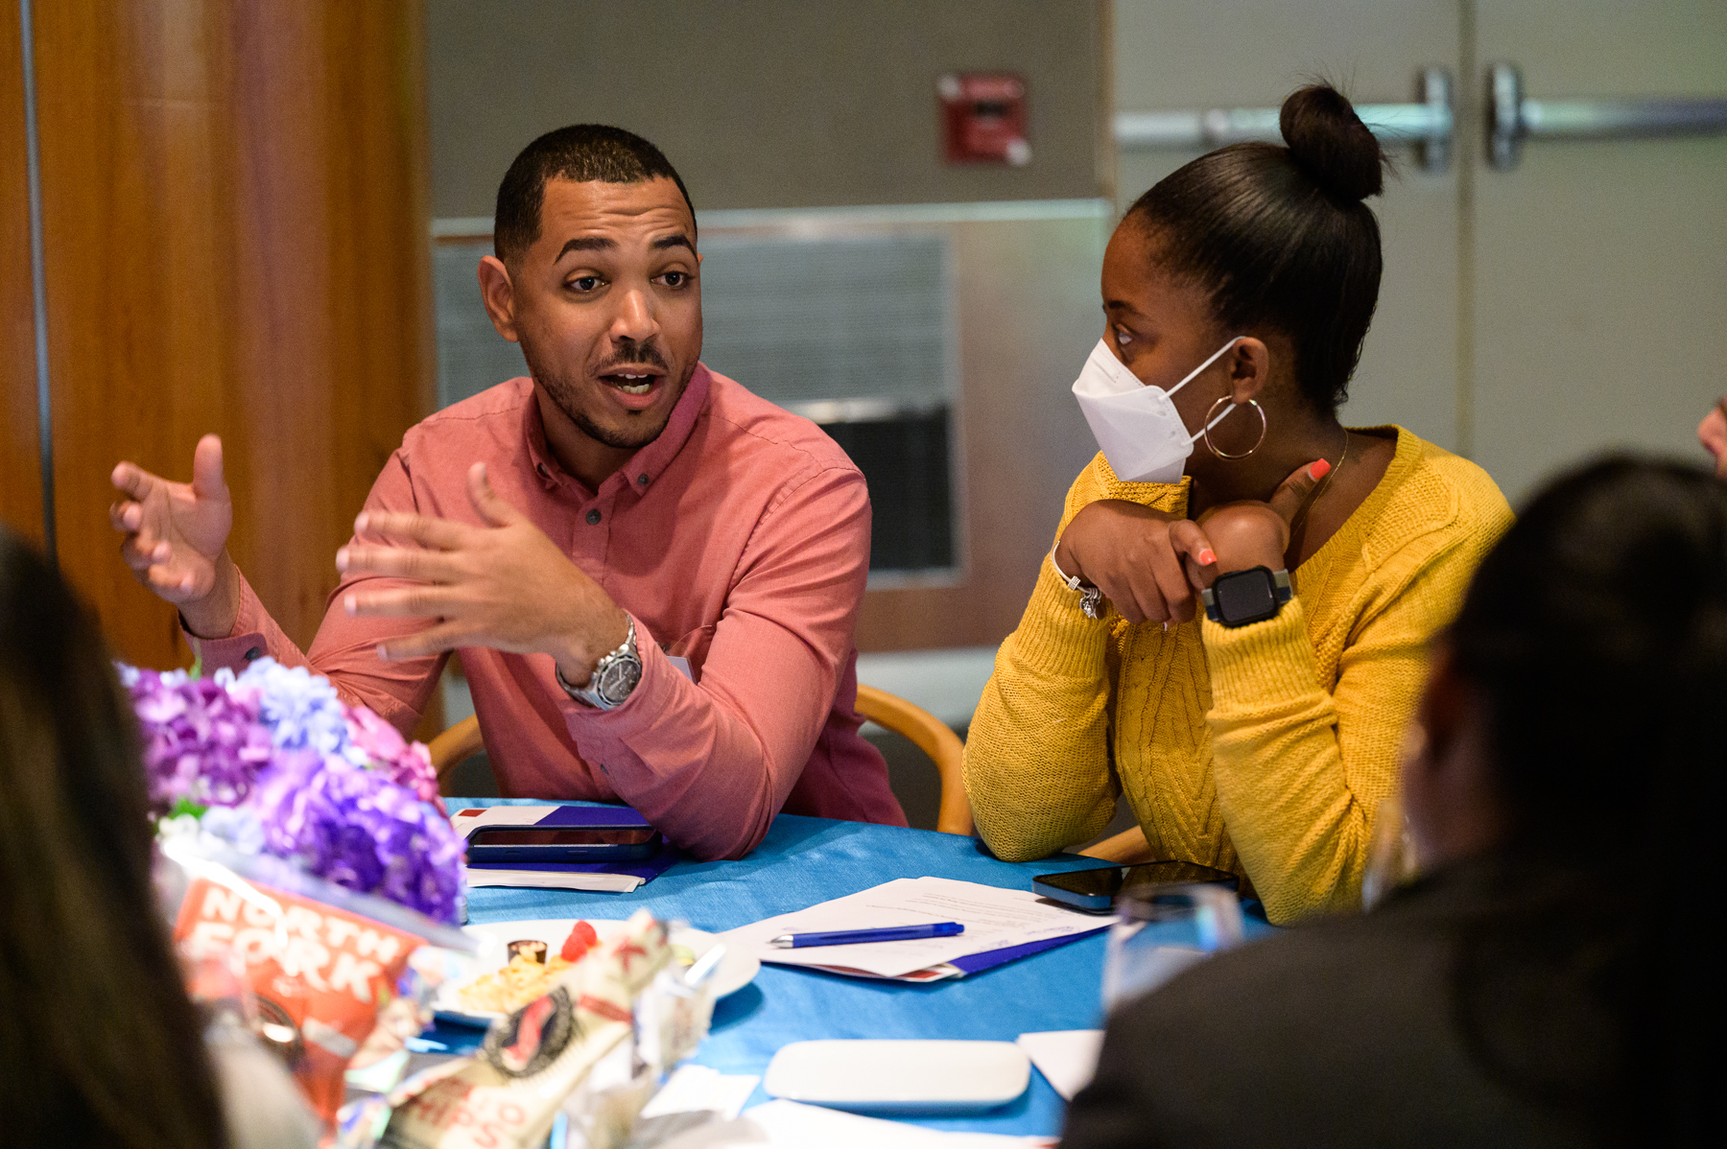
The largest civil legal services organization in the U.S.
5 Boroughs
700+ Dedicated Staff
100,000+ New Yorkers Helped Annually

Slide 4
Program Areas
Consumer Rights.
Tenant/Housing Rights.
Employment.
Foreclosure Protection.
Family Law.
Veterans Justice.
Access to Benefits.
Disabilit.
Education.
Immigration.
Anti-Discrimination Work.
Disaster Relief.
Tax.
Veterans Justice
Access to Benefits
Disability
Education
Immigration
Anti-Discrimination Work
Disaster Relief
LGBTQ/HIV
Consumer Rights
Housing
Employment
Family Law
Notes:
Notes
____________________________________________________________________
____________________________________________________________________
____________________________________________________________________
____________________________________________________________________
____________________________________________________________________
____________________________________________________________________
____________________________________________________________________
____________________________________________________________________
____________________________________________________________________
____________________________________________________________________

Slide 5
Our Clients
Low-income New Yorkers, usually at or below 200% of poverty.
Federal poverty line = approximately $15,600 for an individual.
2 million New Yorkers live at or below 100% of the poverty line.
4.6 million New Yorkers live at or below 200% of the poverty line.
5

Slide 6
Our pro bono work by the numbers
150+ clinics annually
4,100+ pro bono cases handled annually by firms/corporations
100 firms and corporations
4,750+ volunteers
$80M value of donated time

Slide 7
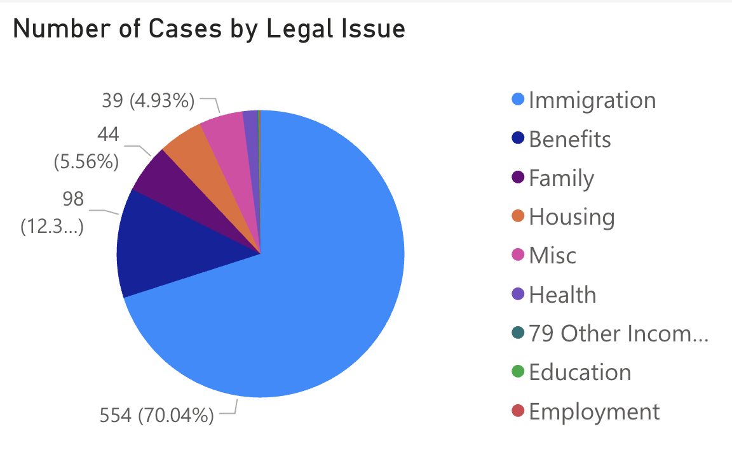
Gibson & LSNYC – a case study in impact
Since January 1, 2024:
791 cases
651 volunteers
216 children benefitting
10+ distinct initiatives

Slide 8
Agenda
The Immigration Detention Crisis
Habeas Corpus Overview
Clinic Tasks & Resources
Interview Tips
8

Slide 9
PART I:
The Immigration Detention Crisis

Slide 10
According to the Vera Institute, more people than ever before are in civil immigration detention – approximately more than 60,000 people across the US. In the first 4.5 months of this administration, ICE detained people nearly 200,000 times. A 46% increase from the past administration for the same time-period.
Many of the facilities where individuals are detained are not even acknowledged on ICE’s own website. A Vera Institute report found that individuals were detained at 436 facilities, but ICE’s own website only acknowledges 163 facilities.
Conditions in detention are harsh and inhumane. Many detention centers have poor medical care, unsafe conditions, and barriers to communicating with counsel.
Targeting marginalized communities. People are being detained without regard to whether they have meritorious claims for relief. Most of the time, those detained do not present a flight risk or a danger to the community.
UNPRECEDENTED RISE IN IMMIGRATION DETENTION
10

Slide 11
Massive Increase in Detention Resources
$170B. As of July 2025, $170 billion has been earmarked for immigration- and border enforcement-related funding, including $45 billion for building new immigration detention centers, including family detention facilities.
116K. The new budget is 62% larger budget than the entire federal prison system and could result in daily detention of at least 116,000 non-citizens.
3x. $29.9 billion toward ICE’s enforcement and deportation operations, increasing ICE’s annual budget three-fold.

Slide 12
Who is Getting Detained?
41,589 out of 58,766—or 70.8% held in ICE detention have no criminal conviction according to data current as of September 7, 2025.
Many of those with convictions committed only of minor offenses.
ICE is arresting more people at immigration court in New York City than in any other city at immigration court.

Slide 13
Where are people held in immigration detention?
People apprehended locally may initially be held in New York City, but ICE is likely to transfer them elsewhere.
According to TRAC, Texas is the state with the most ICE detainees, followed by Louisiana, California, Georgia and Arizona.

Slide 14
High risk indicators for detention
Scheduled ICE check-in or ISAP appointment
Biometrics appointments which are mandated as part of seeking a form of immigration relief
In-person immigration court
Affirmative case pending and receives a request to appear that seems irregular
Final order of removal that has not been executed or is in reinstatement proceedings
Denied relief, either in front of an agency, or in Immigration Court
Arrested or interfaces with law enforcement officers of any kind
Bottom line: Client are at risk of being detained at any in-person appointment where they will interact with any immigration or law enforcement officials

Slide 15
Particular Detention Harms
Abuse and Neglect. Instances of physical abuse and medical neglect are frequently reported.
LGBTQ Clients. The majority of asylum seekers supported through our pro bono program identify as LGBTQ and are fleeing violence and harassment.
Survivors of Violence. Almost all LSNYC immigrant clients seek relief due to persecution or violence experienced either domestically or in their countries of origin.
Mental Health Needs. Experiences of persecution and violence often lead to anxiety, depression, and various other mental health issues.

Slide 16
Harms to LGBTQ Immigrants
High risk of abuse: LGBTQ people, especially transgender women, face higher rates of harassment, assault, and discrimination in detention.
Unsafe housing: Transgender people are often placed in facilities that do not match their gender identity, making them more vulnerable to violence.
Medical neglect: Access to gender-affirming care, HIV treatment, and other critical health services is often denied or delayed.
Isolation as “protection”: LGBTQ detainees are sometimes placed in solitary confinement for “safety,” but this causes serious mental health harm.

Slide 17
Harms to People with Mental Health Conditions
Unsafe environments: Jails and detention centers are stressful, noisy, and isolating.
Lack of treatment: Many detention centers fail to provide proper health care. Medications are delayed or denied, and therapy is limited.
Increased risk of harm: People with mental illness are more likely to be punished for behavior linked to their condition, such as isolation or self-harm.
Legal barriers: It can be harder for people with mental illness to understand their rights, to advocate for themselves or to communicate effectively with their advocates.

Slide 18
PART II:
Habeas Corpus Overview

Slide 19
What is Habeas Corpus?
Common Law & Statute. Habeas corpus is a common-law writ, codified at 28 U.S.C. § 2241(c)(3), that authorizes a federal district court to order the release of a person “in custody in violation of the Constitution or laws or treaties of the United States."
Constitution. It is enshrined in the U.S. Constitution Suspension Clause (Article I, Section 9, Clause 2): “[t]he Privilege of the Writ of Habeas Corpus shall not be suspended, unless when in Cases of Rebellion or Invasion the public Safety may require it”
Codified at

Slide 20
Core Principles of Habeas
Purpose: To challenge the lawfulness of detention and, if unlawful, secure the person’s release.
Primary Goal: Immediate release from detention if the government cannot legally justify continued custody.

Slide 21
Common Secondary Goals of Habeas
Court-ordered bond hearing (with the burden on the government).
Stay of removal (temporary pause on deportation).
Stay of transfer outside the court’s jurisdiction.
Return to jurisdiction if already transferred.
Improved detention conditions (e.g., medical care, humane treatment).
Access to counsel and communications.

Slide 22
Limits on Habeas Claims
Since 1996 immigration reforms (AEDPA & IIRIRA), habeas petitions in immigration cases have been narrowed.
Courts may hear “as applied” constitutional and procedural challenges to the lawfulness of the detention itself.
Courts may not hear habeas petitions that collaterally attack removal orders (i.e., asking the district court to vacate, remand, or overturn the removal order).
Advocates must strategize carefully around these jurisdictional limitations.

Slide 23
Detention vs. Removal
Habeas can challenge detention conditions or legality of custody.
Habeas cannot challenge the validity of the removal order itself.
Even if habeas succeeds, the client remains subject to the removal order unless that order is separately reopened or terminated in immigration court.
A successful habeas petition might win release from custody (or a new bond hearing), but the client must still fight the removal order in the immigration courts or appeals process.

Slide 24
Primary Habeas Claim #1: Due Process
Violations of the Client’s Constitutional Due Process Rights
The person was detained without adequate notice and an opportunity to be heard as to the legality of the detention.
The court applies the Mathews v. Eldridge balancing framework of (i) the private interests at stake, (ii) the government’s interest, and (iii) the risk of erroneous deprivation.

Slide 25
Due Process Claims, Cont.
Key concepts: Immigration detention is civil detention, not criminal. Its purpose is not punishment. The government’s legitimate interests are limited to flight risk (so that removal can take place if warranted) and potential danger posed by the person to the public (in event of a criminal history).
Factors: there is no flight risk of danger, detention should not be considered “mandatory”, proper procedures weren’t followed, the conditions of confinement pose serious harm.

Slide 26
Primary Habeas Claim #2: APA and Accardi Doctrine
Violations of the Administrative Procedure Act (APA) and the Accardi Doctrine
Under the APA 5 U.S.C. § 706(2)(A) a court “shall . . . hold unlawful and set aside agency action . . . found to be . . . arbitrary, capricious, an abuse of discretion, or otherwise not in accordance with law.” And under the Accardi doctrine, agencies must comply with their own regulations and procedures.

Slide 27
APA/ Accardi Cont.
Ask, has the government violated any statutes or regulations, making for an APA claim? Understanding the procedural posture –including the government’s potential statutory authority to detain – is crucial to determining what protocols apply, and how client’s rights may have been compromised.
Clinic resources will help you to identify what statutes and regulations are relevant.

Slide 28
PART III:
Clinic Tasks & Resources

Slide 29
Clinic Goal
Prepare key Habeas documents in the event clients are detained

Slide 30
Why Prepare Now? Speed is Essential!
Habeas Corpus petitions are ideally filed as soon as practicable after the client is detained – ideally on the same day the client is detained. Moving too slowly risks the client being transferred outside the purview of SDNY, which is among the most favorable jurisdictions for immigration practitioners to litigate a habeas petition.
Having prepared this petition and supporting documents in advance will allow for very fast mobilization, and the best outcome for the client.

Slide 31
Key Habeas Documents
Petition
TRO
Exhibits
Client Declaration

Slide 32
Templates – Check Launch Email
https://www.legalservicesnyc.org/pro-bono-resources/immigration-resources/pro-bono-habeas-clinic/
Password: demandjustice
Key Materials:
Template habeas petition containing the “menu” of potential claims to tailor to your client’s facts
Sample client declaration
Sample recent petitions and decisions that will help further your understanding of the potential claims
Sample motions to proceed with initials only and under seal
Immigration Detention Habeas Primer 101 – an introduction to key concepts and links to further, targeted reading
Roadmap to Habeas Corpus Clinic –outlines the steps and timeframe in detail, including interview guidance and document gathering

Slide 33
Walk Through of Key Templates
Client Declaration
Petition
TRO

Slide 34
Summary of Roadmap Steps
Contact
Contact Client & Set Meeting (held within 1 week)
Prepare
Prepare for Client Meeting
Meet
Meet Client & Gather Facts
Draft & Meet
Draft Client Declaration/Second Client Meeting
Draft
Draft Petition
Share
Share with LSNYC (1 month from launch)
Input
Input Feedback & Finalize (6 weeks from launch)

Slide 35
Time Frame For Deliverables
Now | Meet with LSNYC Mentors
Week 3 | Send Drafts & Meet with LSNYC
Week 5 | Receive Feedback & Meet with LSNYC
Week 6 | Finish Documents

Slide 36
Checklist for Filing a Habeas Case in SDNY
BEFORE your client is detained, have them sign a G-28 so you can communicate with the various agencies within the Department of Homeland Security (USCIS, ICE etc.)
Draft and finalize a habeas petition. The petition can include declarations from your client and the attorney present when the client was detained along with accompanying exhibits.
File either an application for an Order to Show Cause or a Motion for a Temporary Restraining Order. Discuss which is more appropriate with your LSNYC mentor.
File a Motion to Proceed by Pseudonym along with a Memorandum of Law.
File a Civil Cover Sheet.
Depending on the circumstances and the risk of actual removal, you may want to call the Clerk’s Office to alert them to the emergency filing.
Email a copy of the petition to the head of the Immigration practice at the U.S. Attorney’s Office, as of 10/10/25, Brandon Waterman, brandon.waterman@usdoj.gov.
File a request for summons and once issued effectuate service according to the FRCP.

Slide 37
CLE CODE

Slide 38
Intersection with Immigration Court
Habeas petitions must be filed in the court where the detainee is physically located at the time the habeas is filed. So, filing the habeas petition and TRO as soon as possible, ideally the same day, keeps the client in New York and prevents their transfer to a less favorable jurisdiction.
This also prevents the client’s immigration case from being moved to jurisdictions that are legal service provider deserts and where immigration judge grant rates are significantly lower.
If your client has an old order of removal, you may need to file a motion to reopen proceedings and request an emergency stay of removal. Discuss this option with your LSNYC mentor.

Slide 39
Intersection with Immigration Court
Contact your LSNYC mentors to discuss whether your client is eligible for bond in immigration court.
After ICE makes their custody determination, folks can ask an immigration judge (IJ) to review that determination by requesting a bond hearing.
Minimum bond is $1,500, no maximum—discuss feasibility of paying bond with client, there are also some resources to procure bond, check out https://envisionfreedom.org/.
Bond hearings are separate from removal proceedings
If the client is detained and they were previously on the non-detained (i.e. regular) docket, their case will be transferred to the detained docket, where things move on a much quicker timeline. If you are successful getting your case released, the client’s case is again moved to the regular, non-detained docket.
Regardless of how the bond hearing goes, you will still have to present the client’s defenses against removal at the individual hearing.

Slide 40
Intersection with Immigration Court
Mandatory detention has expanded significantly under this administration, making many more people ineligible for bond
Recent case law expands mandatory detention to include anyone who entered the US illegally, regardless of criminal history or how long they have been in the US.
The Laken Riley Act, which impacts individuals who are arrested for low level crimes like shoplifting, even if charges are eventually dropped, makes individuals subject to mandatory detention.
Does not impact individuals who entered with a visa, even if they overstayed their visa.
May still want to request parole with ICE or a hearing with immigration judge despite ICE’s determination.

Slide 41
Bond Eligibility and Hearing
To qualify for bond, the client has to demonstrate that:
They are not a danger to the community
Criminal history (including the extensiveness, recency and seriousness of the criminal activity)
Alleged gang involvement or other negative factors (not paying child support, restraining orders, etc.)
They are not a flight risk
Record appearing for immigration hearings and appointments in the past
Fixed address and length of residence in the US
Family ties
School and employment history
Manner of entry and history of immigration violations
Eligibility for immigration relief
Other community ties

Slide 42
Bond Eligibility and Hearing
If the client is bond eligible, you will need to file a request for a bond hearing.
These are scheduled quickly, so be sure your evidence and hearing preparation is solid before making the request.
The bond hearing can sometimes happen at the same time as the master calendar hearing.
Bond hearings tend to move quickly and don’t always allow for witness testimony beyond the client.
If your client has a criminal history, be aware that many judges will request prejudicial documentation like arrest records and police report. Be prepared to push back on submitting this evidence.

Slide 43
PART IV:
Client Interview Tips

Slide 44
TIPS FOR CLIENT MEETINGS
Good preparation is key to an efficient interview that will minimize emotional stress
Be sensitive and use open-ended questions
Acknowledge that you will be discussing a lot of potentially sensitive information and remind clients that you will keep their information confidential.
When appropriate, review LGBT terminology and ensure that you are using the client’s preferred pronouns
Clients with minor children should be counseled on how to prepare for the possibility of detention which includes making decisions about who will care for their children, providing important information about their child (medications, allergies, etc.) as well as other considerations. LSNYC mentors can provide resources to help facilitate these conversations.

Slide 45
USING INTERPRETERS EFFECTIVELY
Determine whether the client requires an interpreter, and schedule for one if needed ahead of time;
Explain the role of the interpreter to the client;
Establish some ground rules (i.e. speaking for 1-2 sentences to allow for accurate representation, speaking in first person, etc.);
Discuss breaks with the interpreter beforehand. Breaks every 30-40 minutes are advisable, particularly if the content is emotional or otherwise activating;
Interpreters should not hesitate to ask for a pause to look up words online.

Slide 46
REMOTE REPRESENTATION TIPS
Always ask client if they are in a safe space where they can talk privately;
Discuss whether the client has access to reliable phone service or WiFi;
Be flexible – phone calls could drop, you or the client might have to pause or end the conversation for different reasons;
Establish the best method of communication early on, and be mindful of client’s circumstances and offer alternatives.

Slide 47
ANY QUESTIONS?
THANK YOU!

